Slide 1

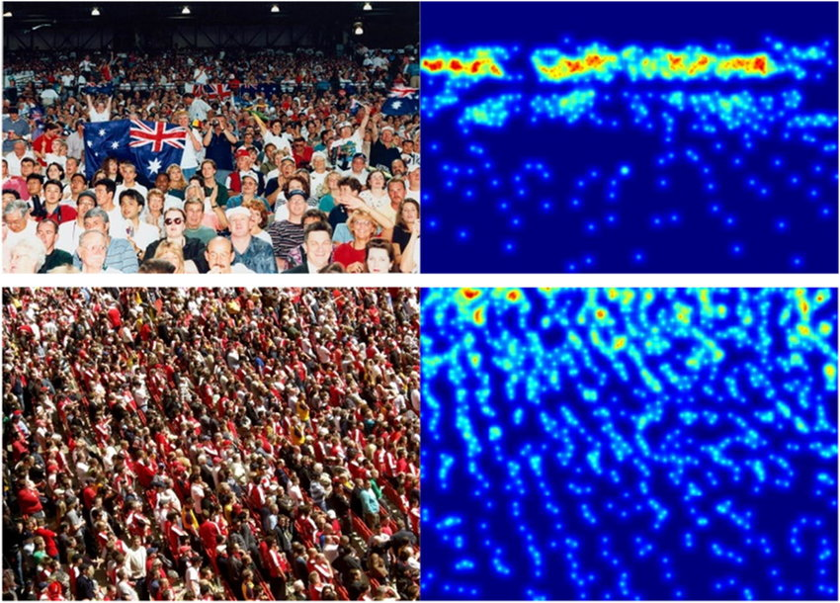
Brindavan College of Engineering
“Detecting Crowd Density Map and Crowd counting with drone Surveillance using Deep Learning Techniques
Under the guidance of
Prof.
Asst. Prof, Dept of CSE, BrCE
ALDI ROHITH (1BO19CS004)
BIJJULA JAYA SIMHA REDDY (1BO19CS025)
CH. MAHESWAR REDDY ( 1BO19CS027)
CHINTAPARTHI RETISH REDDY( 1BO19CS031)

Slide 2
INDEX
Aim & Objectives
Abstract
Introduction
Existing System
Proposed System
System Requirement & Specifications
References

Slide 3
Aim and Objectives
Aim:
The aim of the project is to propose a novel end-to end model called Crowd Attention Convolutional Neural Network (CAT-CNN) that can adaptively judge the position of a human head at each pixel location by automatically encoding a density map and count the number of Humans.

Slide 4
Aim and Objectives
Objective:
The Crowd Dataset is collected from Machine Learning Repository
CAT-CNN that can adaptively assess the importance of a human head at each pixel location to avoid enormous misjudgments in crowd counting.
design a novel classification model that can take input of arbitrary size for training in crowd counting.
And we first explicitly map the prior information of the population-level category of images to feature maps to automatically contribute in encoding a highly refined density map.
Predicting the Human count based on the density map.

Slide 5
Abstract
Counting objects in images is one of the fundamental tasks in deep learning . Currently, deep learning (DL) methods provide the state-of-the-art performance in digital image processing.
we propose a novel end-to end model called Crowd Attention Convolutional Neural Network (CAT-CNN). Our CAT-CNN can adaptively assess the importance of a human head at each pixel location by automatically encoding a confidence map.
To verify the efficiency of our proposed method, extensive experiments are conducted on three highly challenging datasets. Results establish the superiority of our method over many state-of-the-art methods.

Slide 6
Introduction
As the phenomenon of crowd congestion is becoming serious, safety- and security-oriented tasks– such as public safety control and traffic safety monitoring– face huge challenges.
Manual analysis of the degree of crowd aggregation not only cannot achieve high accuracy but also will perform low efficiently.
In contrast, deep-learning-based methods are more applicable at present since their process not only eliminates manual efforts but also can analyze crowd aggregation accurately and quickly.

Slide 7
Existing System
In recent years, crowd counting has drawn much attention and various methods have been proposed, especially in deep learning. Next, we will give these methods some introductions.
Traditional detection-based algorithms such as Haar wavelets , HOG , and LBP occupy an important position in early works.
Regression-based methods learn a mapping between high level features and crowd counts.
CNN-based methods
Image based Methods

Slide 8
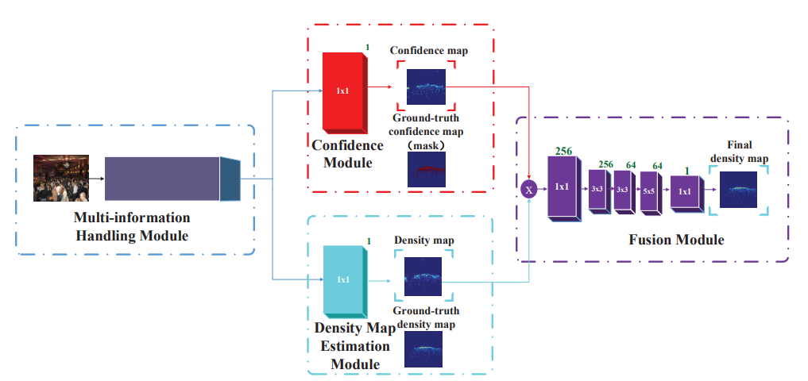
Proposed System

Slide 9
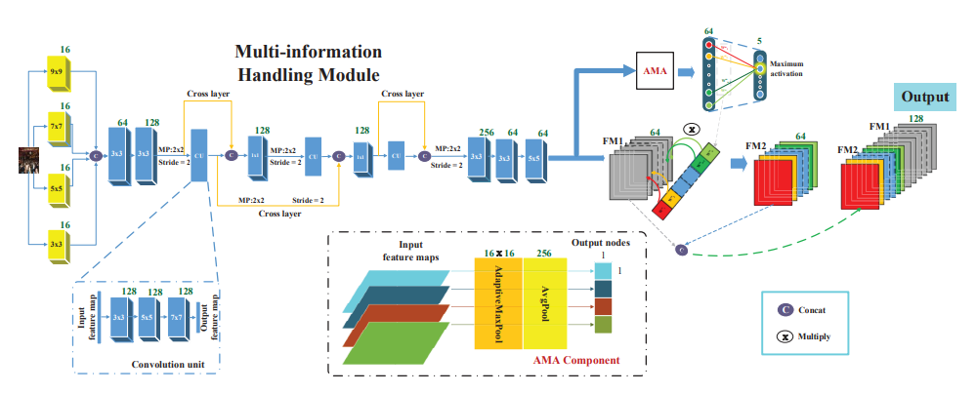
Proposed System

Slide 10
System Req. & Specs
Software Requirements
Scripting language: Python Programming
Scripting Tool: Anaconda Navigator (Jupyter Notebook) & Google Colab
Operating System: Microsoft Windows 8 /10 or 11
Dataset: UCI Machine Learning Repository
Machine Learning and Deep learning Packages : Numpy, Pandas, Matplotlib , Seaborn Packages etc..
Hardware Requirements
Processor : 3.0 GHz and Above
Output Devices : Monitor (LCD)
Input Devices : Keyboard
Hard Disk : 1 TB
RAM : 8GB or Above

Slide 11
References
Babu Sam, D., Sajjan, N.N., Venkatesh Babu, R., Srinivasan, M., 2018. Divide and grow: Capturing huge diversity in crowd images with incrementally growing cnn, in: Proceedings of the IEEE Conference on Computer Vision and Pattern Recognition, pp. 3618–3626.
Boominathan, L., Kruthiventi, S.S., Babu, R.V., 2016. Crowdnet: A deep convolutional network for dense crowd counting, in: Proceedings of the 24th ACM international conference on Multimedia, ACM. pp. 640–644.
Chan, A.B., Liang, Z.S.J., Vasconcelos, N., 2008. Privacy preserving crowd monitoring: Counting people without people models or tracking, in: 2008 IEEE Conference on Computer Vision and Pattern Recognition, IEEE. pp. 1–7.
Chan, A.B., Vasconcelos, N., 2009. Bayesian poisson regression for crowd counting, in: Computer Vision, 2009 IEEE 12th International Conference on, IEEE. pp. 545–551.
Collobert, R., Weston, J., 2008. A unified architecture for natural language processing: Deep neural networks with multitask learning, in: Proceedings of the 25th international conference on Machine learning, ACM. pp. 160–167.

Slide 12
References
Dalal, N., Triggs, B., 2005. Histograms of oriented gradients for human detection, in: Computer Vision and Pattern Recognition, 2005. CVPR 2005. IEEE Computer Society Conference on, IEEE. pp. 886– 893.
Glorot, X., Bordes, A., Bengio, Y., 2011. Deep sparse rectifier neural networks, in: Proceedings of the fourteenth international conference on artificial intelligence and statistics, pp. 315–323.
He, K., Zhang, X., Ren, S., Sun, J., 2015. Delving deep into rectifiers: Surpassing human-level performance on imagenet classification, in: Proceedings of the IEEE international conference on computer vision, pp. 1026–1034.
He, K., Zhang, X., Ren, S., Sun, J., 2016. Deep residual learning for image recognition, in: Proceedings of the IEEE conference on computer vision and pattern recognition, pp. 770–778.
Hossain, M., Hosseinzadeh, M., Chanda, O., Wang, Y., 2019. Crowd counting using scale-aware attention networks, in: 2019 IEEE Winter Conference on Applications of Computer Vision (WACV), IEEE. pp. 1280–1288.

Slide 13


